Slide 1
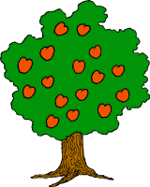
Diagram of the Client’s Orchard

Slide 2
RM/SP
Use the seed as your between block and fertilizer as within block. Block with 3 trees and randomly assign the fertilizer within the within block and randomly assign blocks across the orchard to grab all the geography of the orchard.

Slide 3
BF[2]
Block by the columns within the orchard and then randomly assign a treatment of fertilizer and seed within each block.

Slide 4
CB[1]
2 types of seeds as blocking factors.
3 fertilizers as treatment levels.

Slide 5
Crohn’s
Adds are between block people are within block. Randomly assign the order they see them in.

